Slide 1
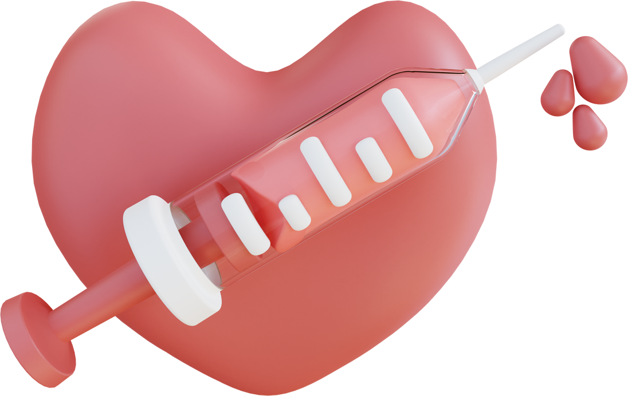



MIMIC III NLP
Joshua Ludolf
AI 395T - AI in Healthcare
University of Texas at Austin

Slide 2


WHY CLINICAL NOTES MATTER?
Clinical Notes contain: diagnoses, symptoms, timelines; but are unstructured. Additionally, they have abbreviations, noise, and varied terminology across clinicians (e.g. different ICU codes, etc.) With Natural Language Processing, allows extracting disease entities to surface cohorts and patterns.
Notes:
SciSpacy = biomedical entities
ClinicalBERT = contextual doc embeddings

Slide 3
OBJECTIVES
Extract disease-related entities from MIMIC III clinical notes
Compare SpaCy vs SciSpacy extraction coverage
Train Word2Vec embeddings and visualize with t‑SNE
Integrate ClinicalBERT for document embeddings & clustering
Deliver comparative metrics and dashboard

Slide 4




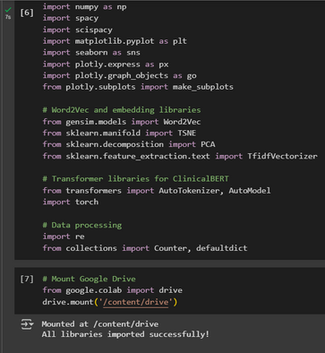
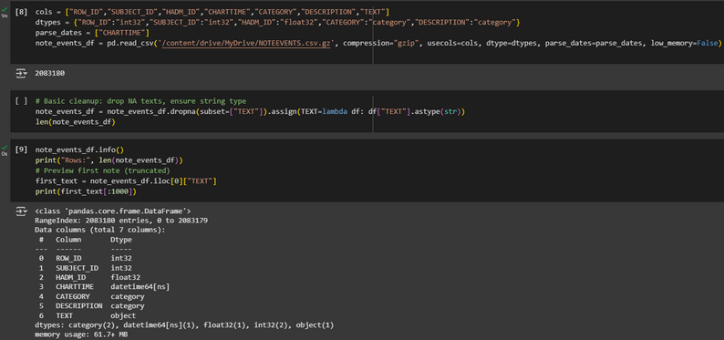
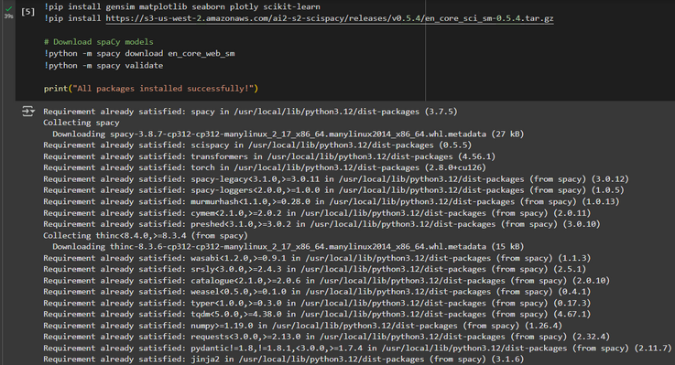
SETUP
Installed required spacy, scispacy, pytorch, gensim, matplotlib, seaborn, scikit-learn.
Loaded in MIMIC III NOTEEVENTS.csv.gz into dataframe: note_events_df
Cleaned dataframe by dropping missing values in the TEXT column and enusring it was type string for processing

Slide 5

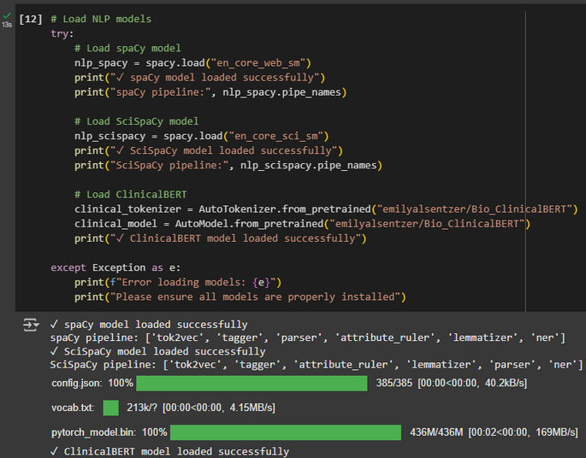
NLP MODELS CONFIGURATION
spaCy model: en_core_web_sm (pipeline shown)
SciSpacy model: en_core_sci_sm
ClinicalBERT: emilyalsentzer/Bio_ClinicalBERT (tokenizer + model)
Model loading checks & fallbacks
Notes:
SciSpacy = biomedical entities
ClinicalBERT = contextual doc embeddings

Slide 6
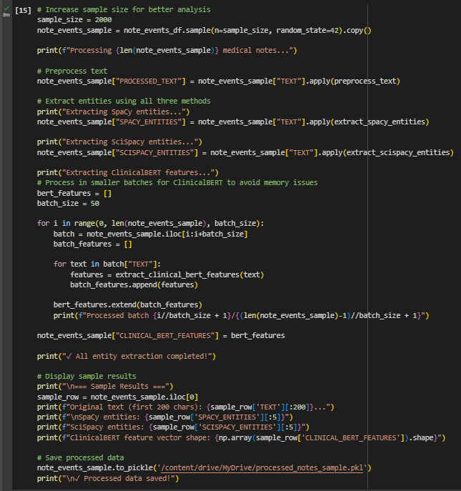

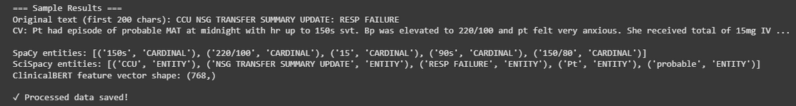
ENTITY EXTRACTION IMPLEMENTATION
spaCy with keyword filtering to focus disease terms
SciSpacy to capture clinical concepts missed by general NER
Columns created: SPACY_ENTITIES, SCISPACY_ENTITIES

Slide 7
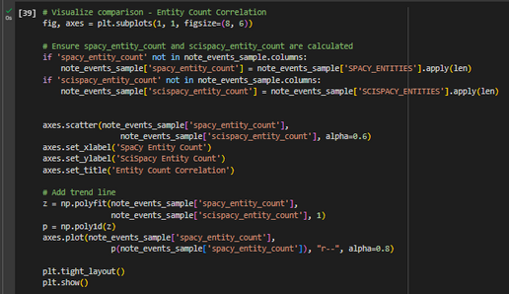
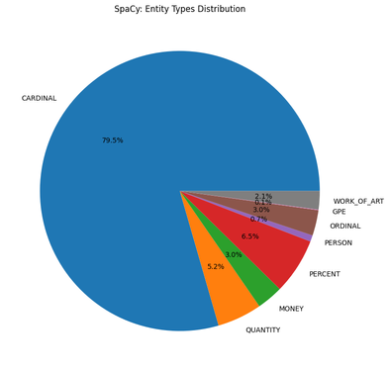
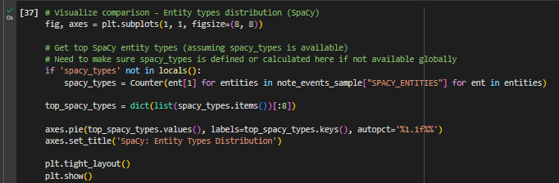
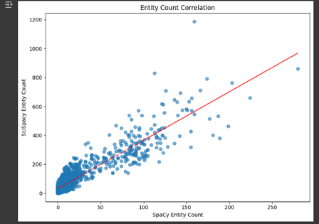
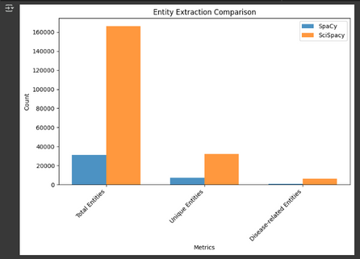
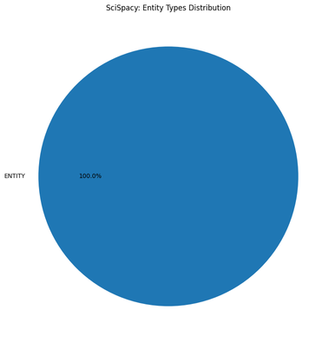
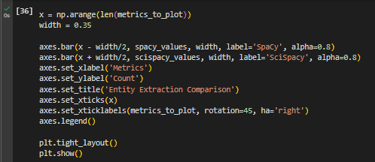
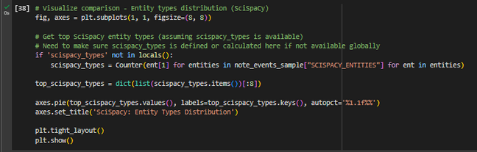
ENTITY EXTRACTION IMPLEMENTATION CONT.

Slide 8
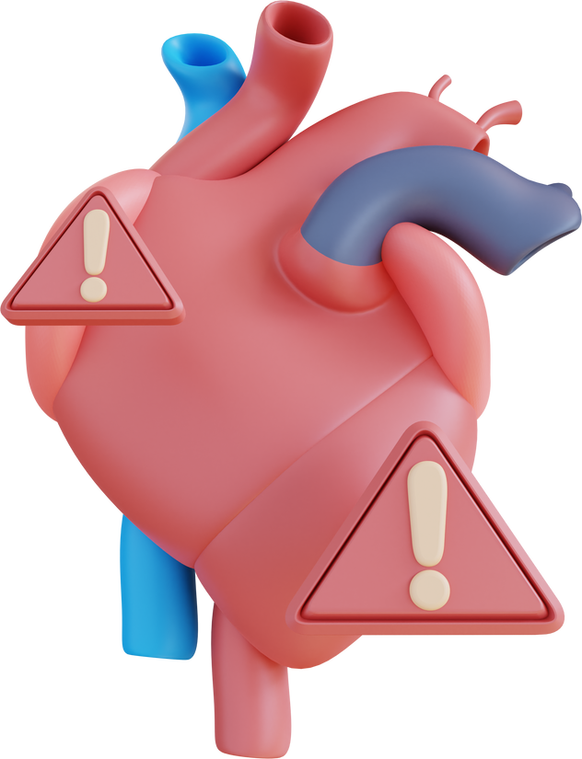
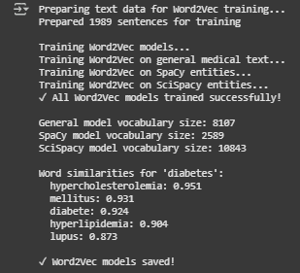
EMBEDDINGS & RELATIONSHIPS
Word2Vec trained on general medical text + entity-only corpora
Learned neighbors reveal synonyms, abbreviations, and collocations
Example: nearest neighbors for “diabetes” or “sepsis”

Slide 9

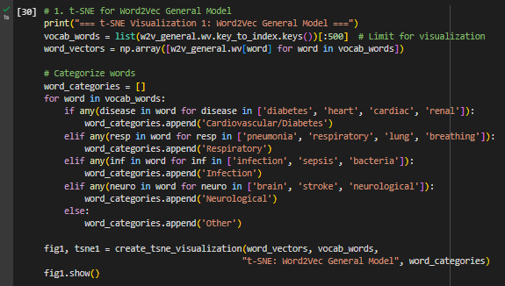
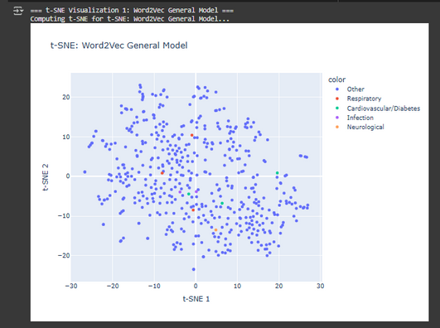
VISUAL DISCOVERY
t‑SNE applied to Word2Vec vocab, SpaCy entities, SciSpacy entities, ClinicalBERT docs
Sampling strategy used to keep plots interpretable (300 words / 500 docs)
Observed clusters: cardiovascular, respiratory, infectious, neurological islands

Slide 10
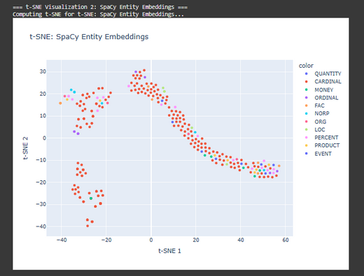
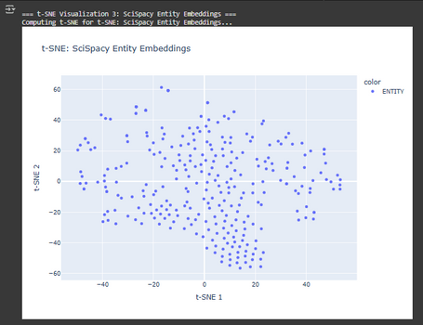
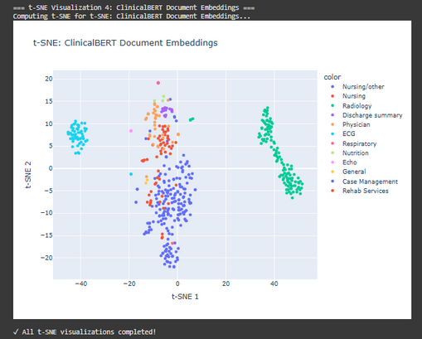
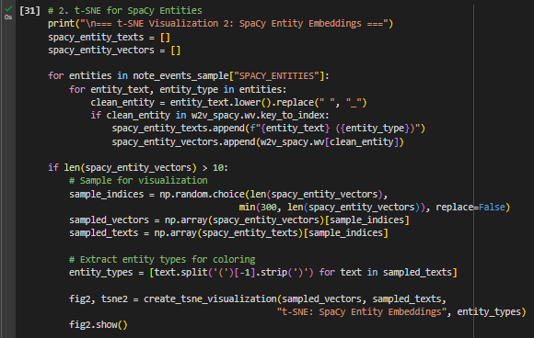
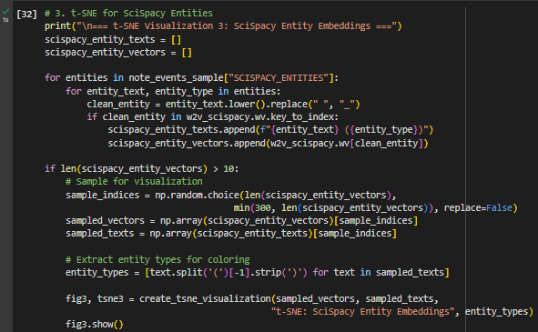
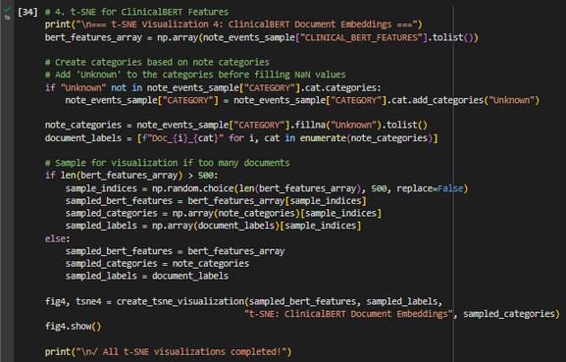
VISUAL DISCOVERY
CONT.

Slide 11
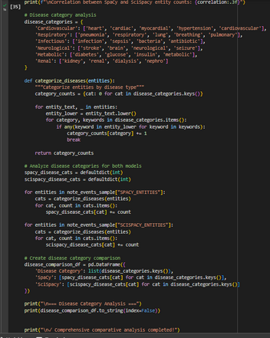
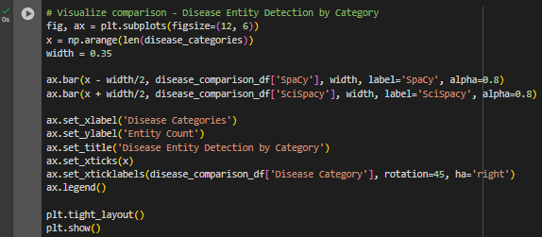
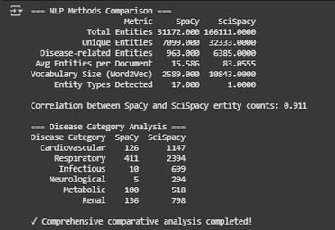
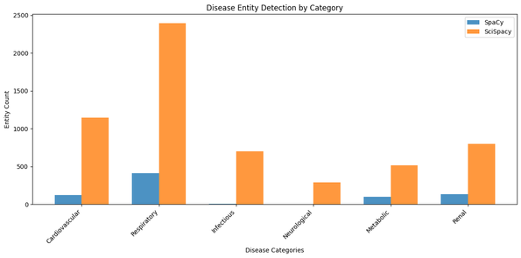
SPACY VS. SCISPACY COMPREHENSION
SciSpacy finds more biomedical concepts; Spacy finds common names/places

Slide 12
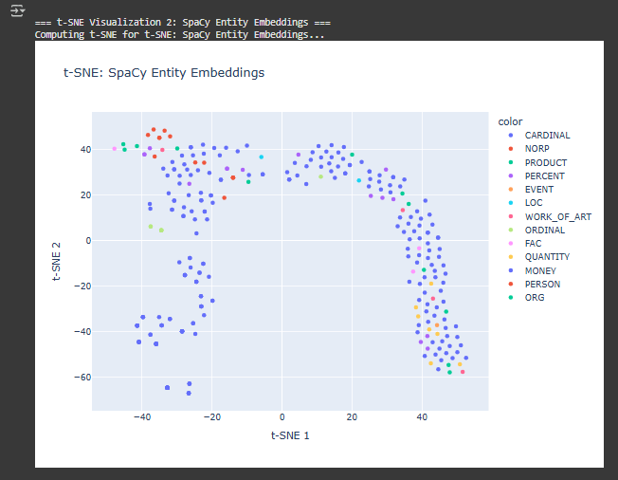
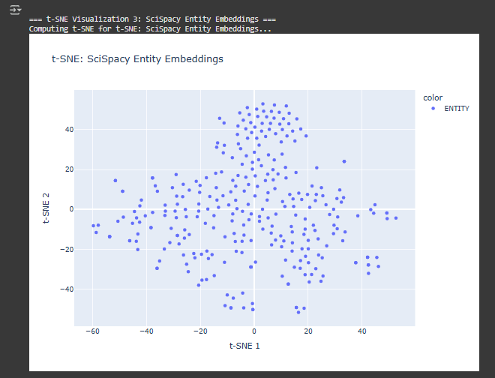

SPACY VS. SCISPACY COMPREHENSION
CONT.
Spacy
More Labels, but decenteralized
SciSpacy
Less Labels, but centeralized

Slide 13

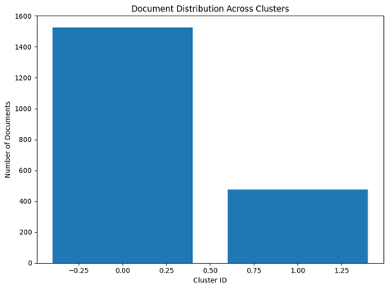
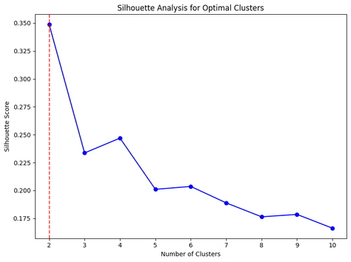
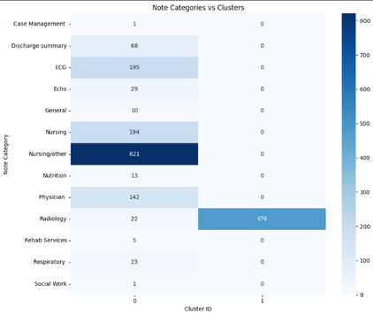
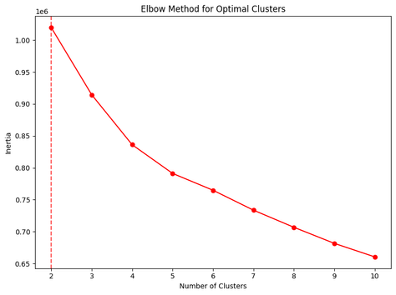
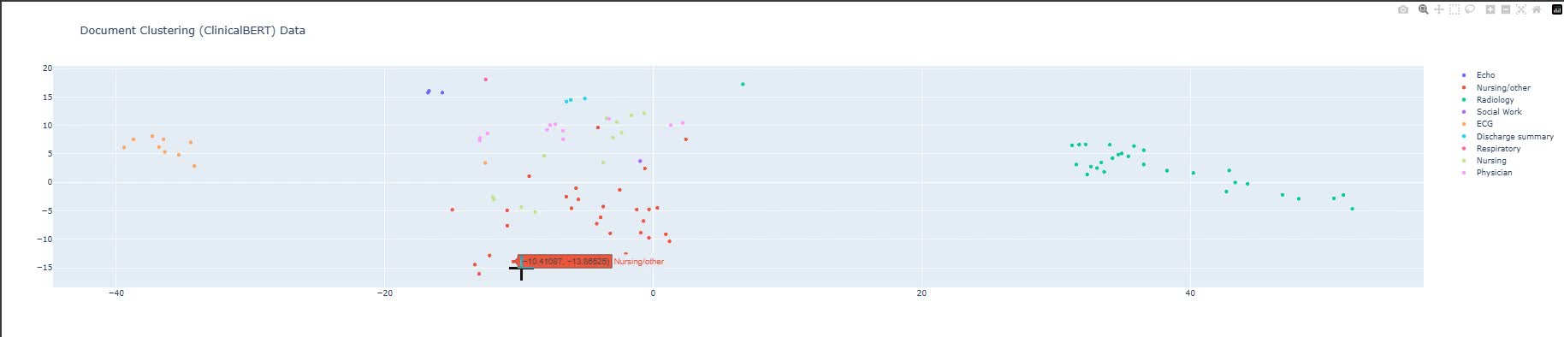

ClinicalBERT
ClinicalBERT → mean pooled doc vectors → KMeans clustering
Chose k via silhouette and elbow; compared clusters to TF‑IDF (ARI / NMI)
Representative documents per cluster reveal clinical themes (e.g., post-op infection, CHF)

Slide 14

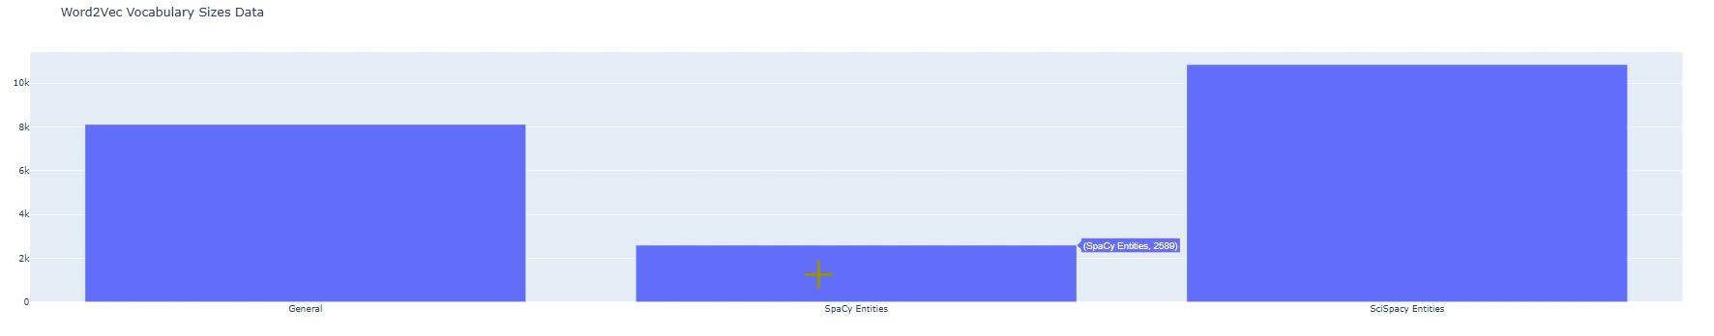
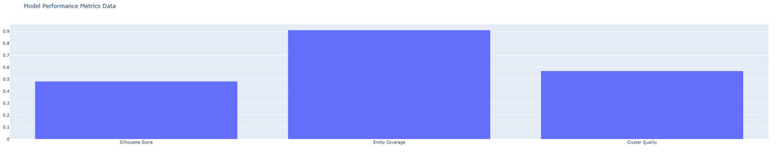
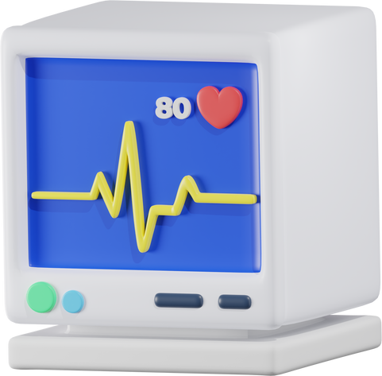
Results
nteractive dashboard: entity comparison, disease distribution, clustering view, vocab sizes, summary table
Saved artifacts: processed_notes_sample.pkl, three Word2Vec models, nlp_analysis_summary.json
How stakeholders use it: explore clusters, export cohorts, prioritize chart reviews

Slide 15

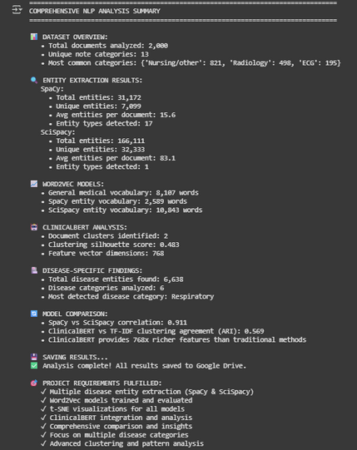
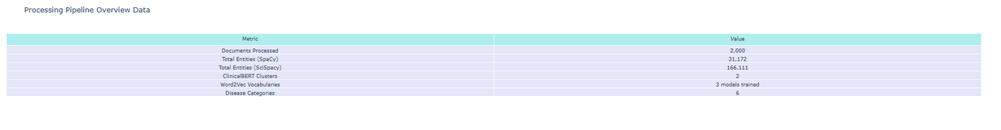
WHERE THIS LEADS US?
Combined pipelines increase disease signal coverage; ClinicalBERT uncovers document-level themes
Scale to full dataset, fine‑tune ClinicalBERT, add entity linking / clinician validation

Slide 16

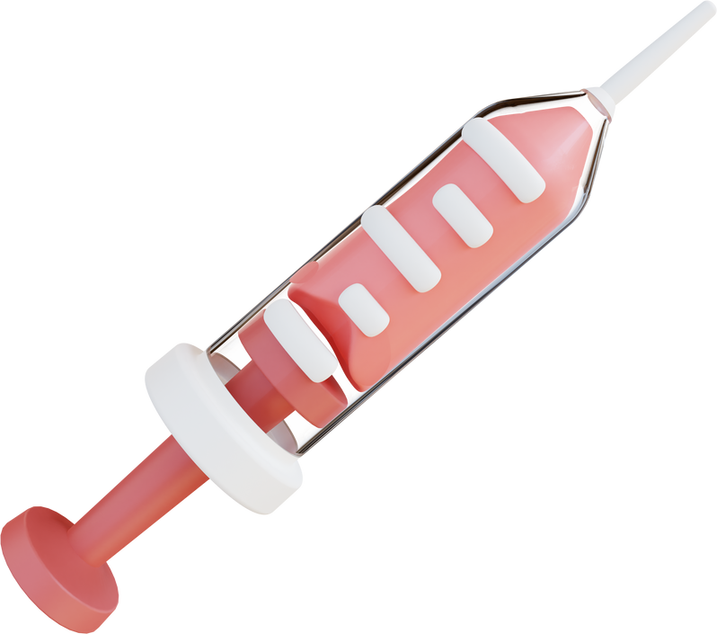
THANK YOU!

